Slide 1
TASK-3
Entering/Solving a given
website using Burpsuit.
-Vijayalakshmi.S

Slide 2
STEP TO BE FOLLOWED:
STEP 1: OPEN VMWARE WORKSTATION AND LOGIN TO KALI LINUX STEP 2: OPEN BURP SUITE CHECK WHETHER THE INTERCEPT IS ON
STEP 3: OPEN FIREFOR AND SEARCH FOR VULNWEB
STEP 4: CLICK ON http://testasp.vulnweb.com the given interface will be opened
STEP 5: CLICK ON SEARCH BAR AND CLICK THE FOXYPROXY ON
STEP 6: TRY TO ENTER ONE OF THE PAYLOADS SO THE REQUEST WILL BE SENT TO BURPSUITE
STEP 7: AFTER THE REQUEST COMES SEND IT TO INTRUDER AND FORWARD THE REQUEST
STEP 8: ADD THE PAYLOAD POSITION ONLY FOR THE REQUIRED PLACE.
STEP 9: ADD THE XSS PAYLOADS ,WHICH CAN BE DOWNLOADED FROM www.github.com
STEP 10: START THE ATTACK AND CHECK WHETHER THERE IS SUDDEN CHANGE IN LENGTH AND STATUS.
STEP 11: COPY THE URL TO SHOW THE RESPONSE FOR THE PAYLOD THAT HAS BEEN ACCEPTED
STEP 12: COPY THE URL AND SEARCH IT IN FIREFOX
At last will get the required interface.

Slide 3
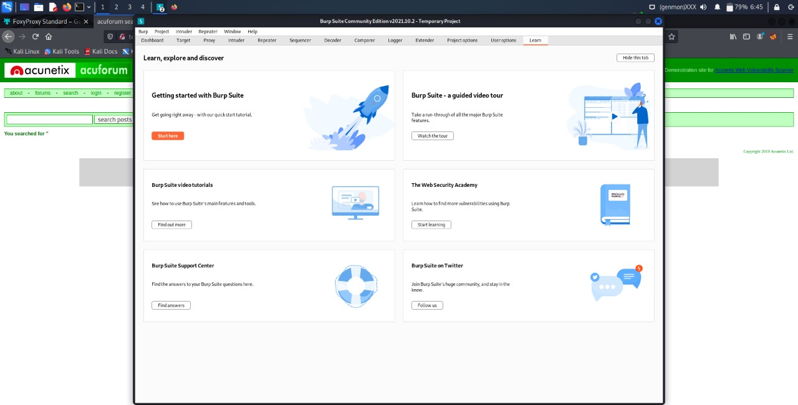

Slide 4
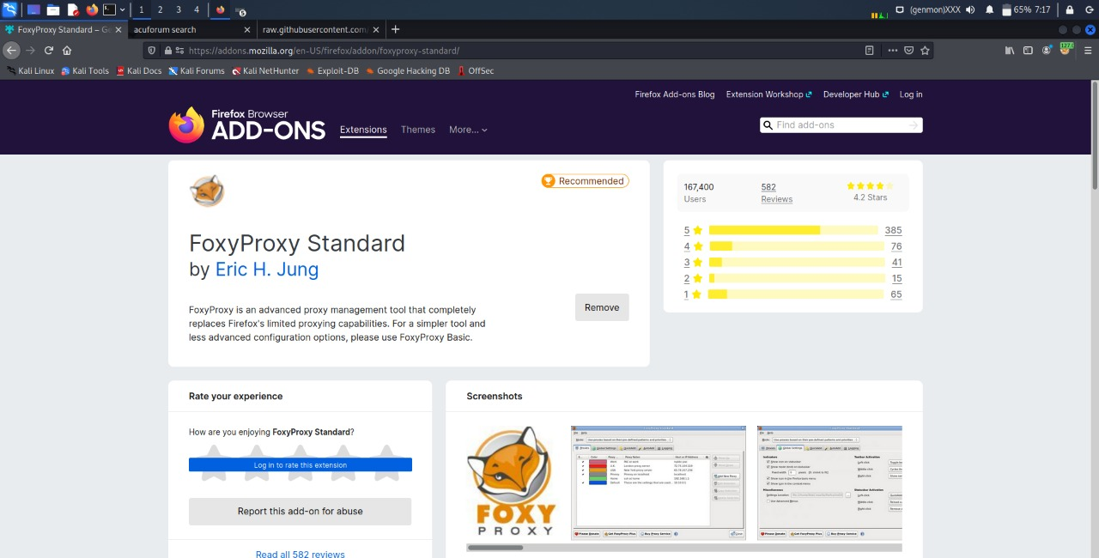

Slide 5
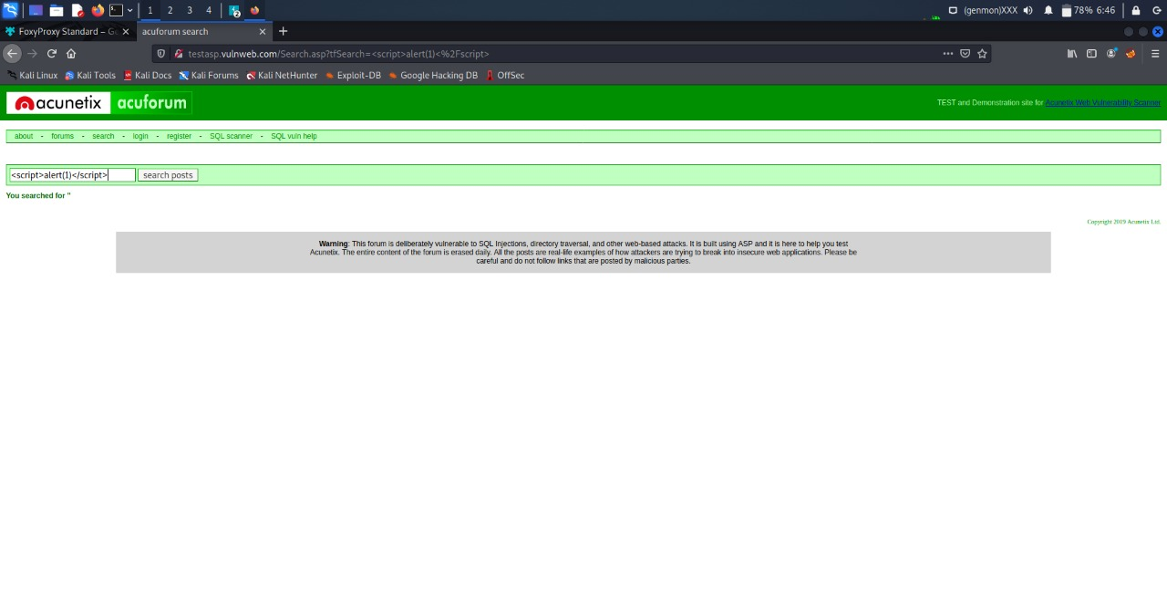

Slide 6
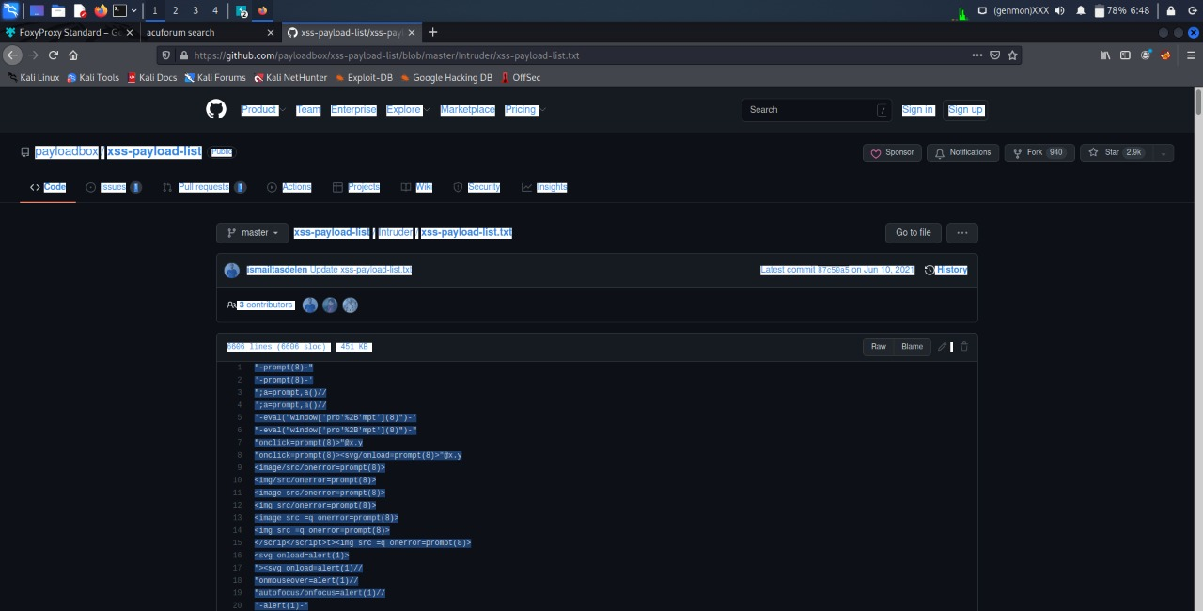

Slide 7
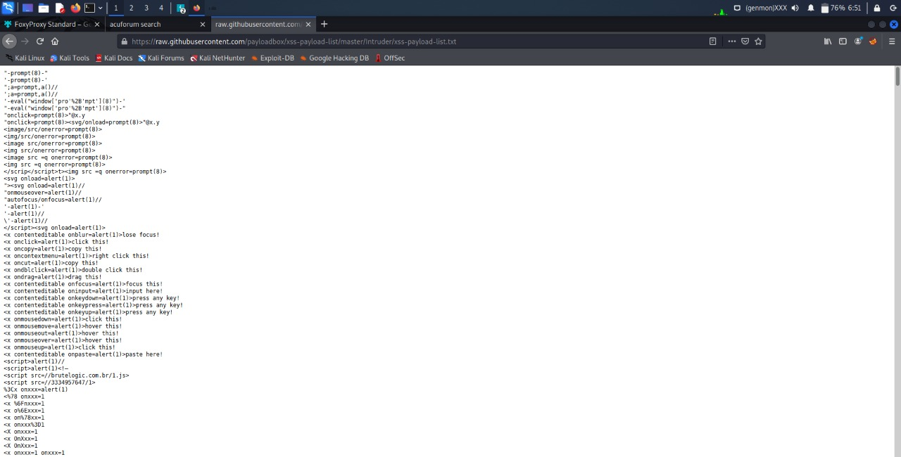

Slide 8
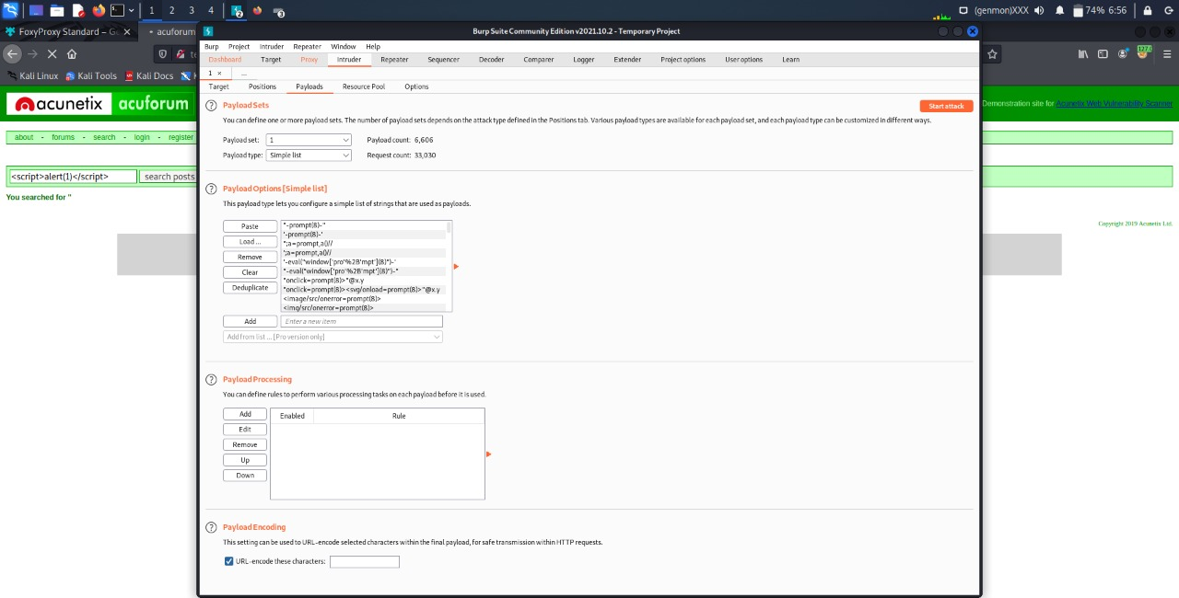

Slide 9
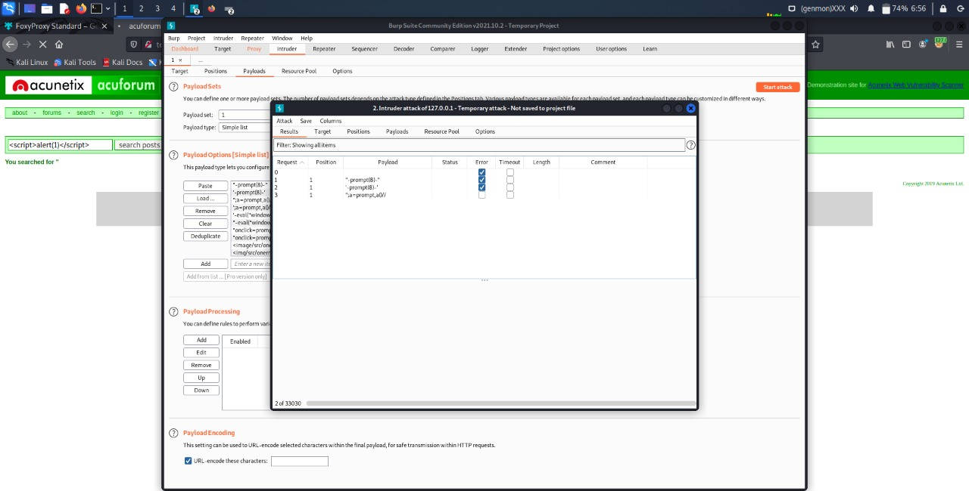

Slide 10
